Slide 1
Three types of call numbers in Alma
Yoel Kortick
Senior Librarian

Slide 2
  Three types of call numbers in Alma
  Permanent Call Number
  Item Call Number
  Temporary Call Number
  Comparative Table

Slide 3

Three types of call numbers in Alma

Slide 4
Three types of call numbers in Alma
There are three types of call number in Alma:
Permanent Call Number
Item Call Number
Temporary Call Number

Slide 5
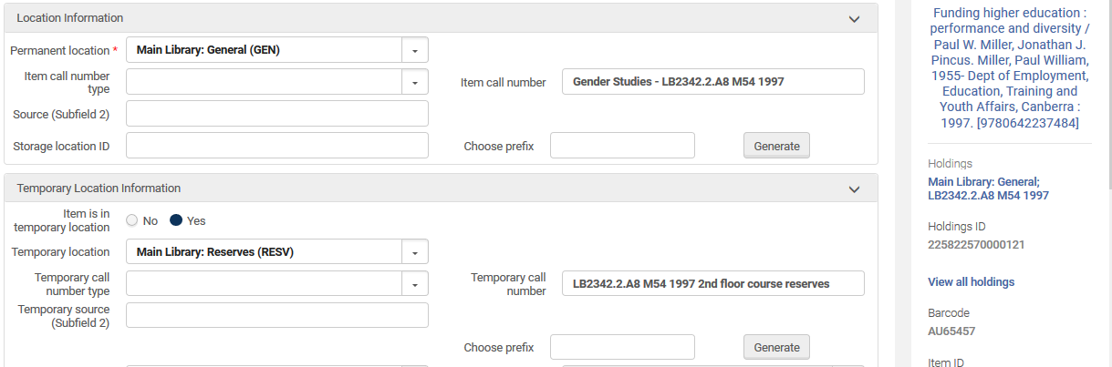
Three types of call numbers in Alma
This is the sample item we will use in this presentation
Item Call Number
Permanent Call Number
Temporary Call Number

Slide 6


Permanent Call Number

Slide 7
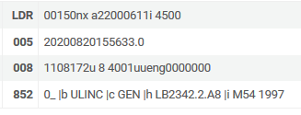
Permanent Call Number – where does it come from?
The permanent call number is in the holdings record 852 field, in subfields k,h,i,j,l,m

Slide 8
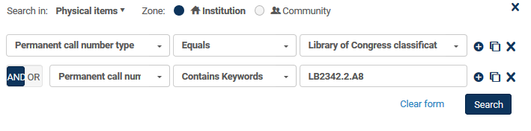
Permanent Call Number – can it be searched?
The permanent call number is searchable in repository search

Slide 9
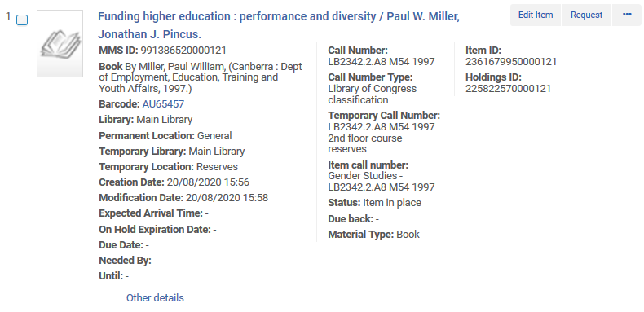
Permanent Call Number – is it in repository search results?
The permanent call number appears in physical items repository search results

Slide 10
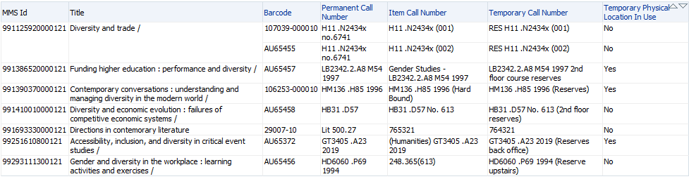
Permanent Call Number – is it in analytics?
The permanent call number appears in Alma Analytics

Slide 11

Permanent Call Number – is it in Primo VE search results?
The permanent call number will appear in Primo VE unless there is a temporary call number and the item is designated as being in a temporary location. For appearance in Primo VE the temporary call number takes precedence over permanent call number.
This is Primo VE initial search results.
This is the temporary call number (see slide 5 for example)

Slide 12
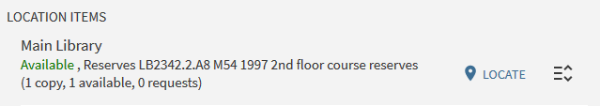
Permanent Call Number – is it in Primo VE search results?
This is Primo VE GetIt tab.
Here too, for appearance temporary call number takes precedence over permanent call number if the item is designated as being in a temporary location.
This is the temporary call number (see slide 5 for example)

Slide 13
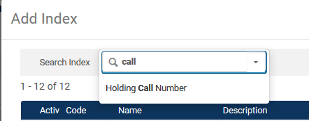
Permanent Call Number – is it in Primo VE search indexes?
The permanent call number can be added as a Primo VE search index.
In Primo VE it is called by default “Holding Call Number”

Slide 14
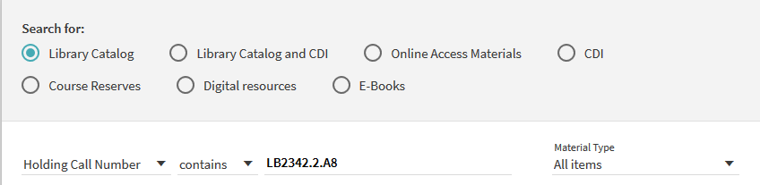

Permanent Call Number – is it in Primo VE search indexes?

Slide 15

Item Call Number

Slide 16
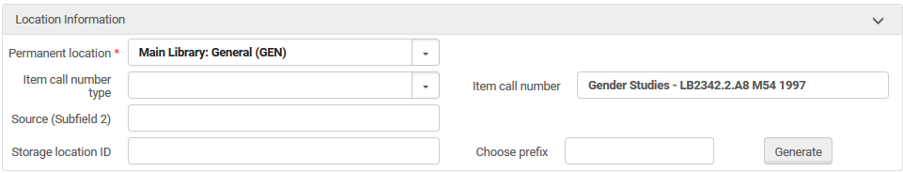
Item Call Number – where does it come from?
The item call number is manually entered in the item

Slide 17
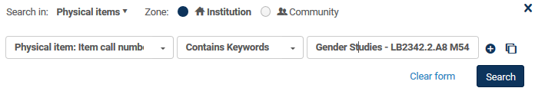
Item Call Number – can it be searched?
The item call number is searchable in repository search

Slide 18
Item Call Number – is it in repository search results?
The item call number appears in physical items repository search results

Slide 19
Item Call Number – is it in analytics?
The item call number appears in Alma Analytics

Slide 20
Item Call Number – is it in Primo VE search results?
The item call number does not appear in Primo VE initial search results.
This is the temporary call number (see slide 5 for example)
We do not see here the “item call number”

Slide 21
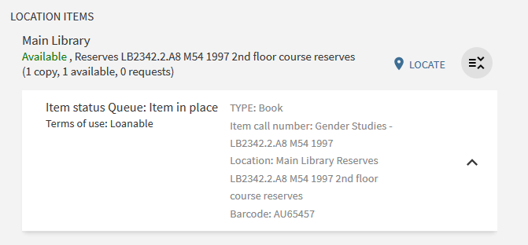
Item Call Number – is it in Primo VE search results?
This is Primo VE GetIt tab.
Here the item call number appears when expanding the item

Slide 22
Item Call Number – is it in Primo VE search indexes?
The item call number cannot be added as a Primo VE search index.
Of the three call numbers only the “Holding Call Number” can be added as a Primo VE search index.

Slide 23

Temporary Call Number

Slide 24
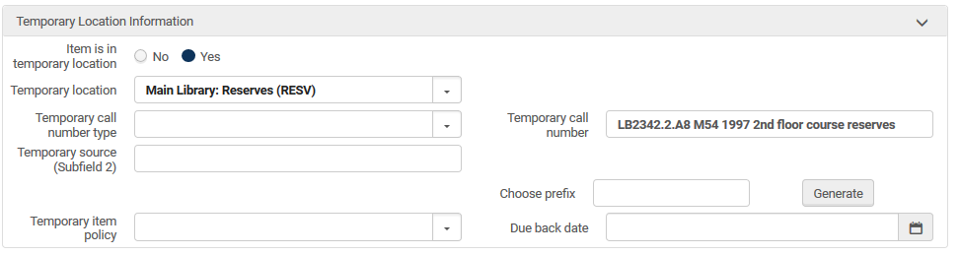
Temporary Call Number – where does it come from?
The temporary call number is manually entered in the item

Slide 25
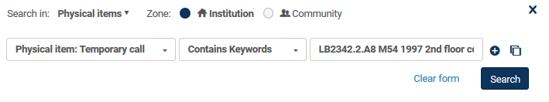
Temporary Call Number – can it be searched?
The temporary call number is searchable in repository search

Slide 26
Temporary Call Number – is it in repository search results?
The temporary call number appears in physical items repository search results if the item is designated as being in a temporary location

Slide 27
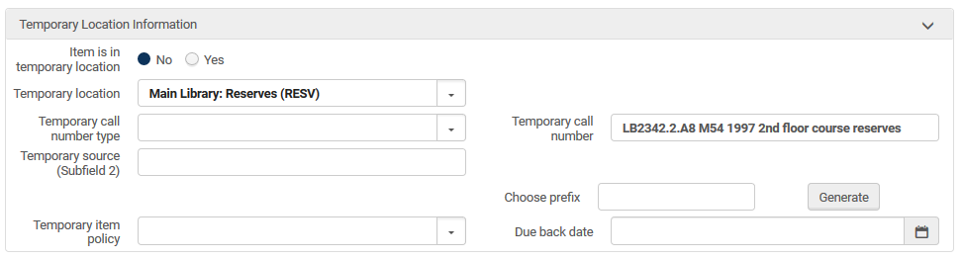
Temporary Call Number – is it in repository search results?
If this is “No” then the temporary call number will still be searchable, but it will not appear in repository search results

Slide 28
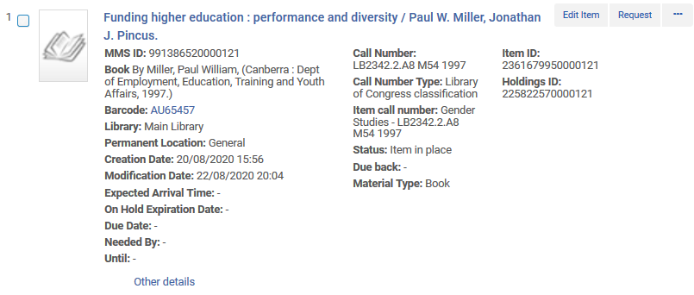
Temporary Call Number – is it in repository search results?
Now we do not see the temporary call number in physical items repository search results because we updated the item to not be designated as being in a temporary location
Temporary location no longer appears

Slide 29
Temporary Call Number – is it in analytics?
The temporary call number appears in Alma Analytics, regardless of whether or not it is designated as being in a temporary location.

Slide 30
Temporary Call Number – is it in Primo VE search results?
The temporary call number does appear in Primo VE initial search results if the item is designated as being in a temporary location. Otherwise the permanent location will appear.
The reason we now see the temporary call number is because the item is designated as being in a temporary location.

Slide 31
Temporary Call Number – is it in Primo VE search results?
This is Primo VE GetIt tab.
Here the temporary call number appears when expanding the item results if the item is designated as being in a temporary location.

Slide 32
Temporary Call Number – is it in Primo VE search indexes?
The temporary call number cannot be added as a Primo VE search index.
Of the three call numbers only the “Holding Call Number” can be added as a Primo VE search index.

Slide 33

Comparative table

Slide 34
Comparative Table
Type | Can be searched in Repository Search | Appears in Repository Search Results | Appears in Analytics | Can be searched in Primo VE | Appears in Primo VE initial search results | Appears in Primo VE GetIt expand item
Permanent | Yes | Yes | Yes | Yes | Yes if not in temp. location | Yes
Item | Yes | Yes | Yes | No | No | Yes
Temporary | Yes | Yes if in temp. location | Yes | No | Yes if in temp. location | Yes if in temp. location

Slide 35
xxx@exlibrisgroup.com

